Slide 1

Home
Workouts
ExerPals.com
People
Messaging
EP

Slide 2
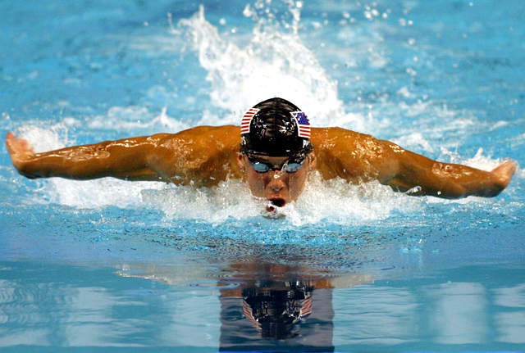
Home
Workouts
ExerPals.com
People
Messaging
This Photo by Unknown Author is licensed under CC BY-NC-ND
EP

Slide 3
Home
Workouts
ExerPals.com
People
Messaging
Click to enter your location
Search
EP

Slide 4
Home
Workouts
ExerPals.com
People
Messaging
EP

Slide 5
Home
Workouts
ExerPals.com
People
Messaging
EP

